Slide 1

Acquainting Yourself with Board Policy
Webinar Series 2024/2025
March 4, 2025
Presented by:
Angela L. Irwin, Owner
AirWin Educational Services, LLC

Slide 2
Importance of Board Policy
Provides direction and consistency
Reduces risk and ensures compliance
Promotes good governance

Slide 3

Best Way to Acquaint Yourself
Request a copy of board policy manual
Start with the table of contents
If new to board, focus on key areas (i.e. financial oversight, board operations, program, etc.)
Look for summaries and/or “cheat sheets” for key policies
Understand “best practice” and “legally required” policy selection(s)
Notes:
Why is structure important to know? Why did I choose this as one of the “critical” three? Knowing the structure is critical to your performance as a board and/or board member – why? The charter school legislation was enacted because public education needed a “performance” shake up – meaning, as we learned in President Reagan’s a Nation at Risk report, our public education system in this country was failing – we needed an educational reform movement to force positive change in educational outcomes; every charter school operating in our State/country today is responsible for ensuring performance – not just for itself but for all of public education – nationwide! Through the appropriate checks and balances, you, board members, have been charged with the task of overseeing your charter school’s performance; if that does not work, your school is closed; if charter schools do not work, then this educational reform effort will be deemed a failure and shutdown – it is important to know the structure because, within it, you have a significant role to play in ensuring this educational reform effort works - in Michigan, this is how it has been designed to work . . .
(Angie: Review and highlight law)

Slide 4

Applying Board Policy to Decision-Making
Thoroughly review board meeting packet(s)
Ensure understanding of board policy language
Consider each agenda item and its “policy implications”
Assume preparedness to deliberate on policy matters at board meetings
Notes:
Why is structure important to know? Why did I choose this as one of the “critical” three? Knowing the structure is critical to your performance as a board and/or board member – why? The charter school legislation was enacted because public education needed a “performance” shake up – meaning, as we learned in President Reagan’s a Nation at Risk report, our public education system in this country was failing – we needed an educational reform movement to force positive change in educational outcomes; every charter school operating in our State/country today is responsible for ensuring performance – not just for itself but for all of public education – nationwide! Through the appropriate checks and balances, you, board members, have been charged with the task of overseeing your charter school’s performance; if that does not work, your school is closed; if charter schools do not work, then this educational reform effort will be deemed a failure and shutdown – it is important to know the structure because, within it, you have a significant role to play in ensuring this educational reform effort works - in Michigan, this is how it has been designed to work . . .
(Angie: Review and highlight law)

Slide 5

Effective Board Policy Practices
Be sure policies are clear and concise
Ensure regular review and updating
Become more familiar with policy language through communication and/or training programs
Notes:
Why is structure important to know? Why did I choose this as one of the “critical” three? Knowing the structure is critical to your performance as a board and/or board member – why? The charter school legislation was enacted because public education needed a “performance” shake up – meaning, as we learned in President Reagan’s a Nation at Risk report, our public education system in this country was failing – we needed an educational reform movement to force positive change in educational outcomes; every charter school operating in our State/country today is responsible for ensuring performance – not just for itself but for all of public education – nationwide! Through the appropriate checks and balances, you, board members, have been charged with the task of overseeing your charter school’s performance; if that does not work, your school is closed; if charter schools do not work, then this educational reform effort will be deemed a failure and shutdown – it is important to know the structure because, within it, you have a significant role to play in ensuring this educational reform effort works - in Michigan, this is how it has been designed to work . . .
(Angie: Review and highlight law)

Slide 6


Executing Policy Direction
Consult policy when decision-making is or seems unclear
Ensure access to policy language during board meetings
Ensure school leadership is executing on policy(ies) through clear operational guidelines
Be aware of policy service provider and reach out with questions, accordingly

Slide 7
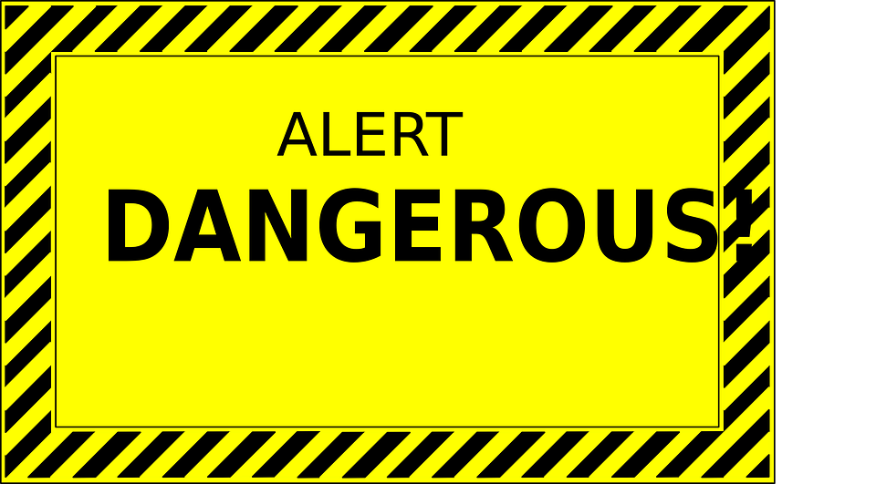
Potential Pitfalls Alert
Unclear or non-specific language
Outdated policies
Inconsistent language with legal requirements
Not reviewed or updated regularly
Lack of enforcement
Lack of communication/training

Slide 8
Conclusion Quote . . .
“Rules, regulations (and policy) do not make a person correct – they only make them consistent.”
Calvin Coolidge

Slide 9
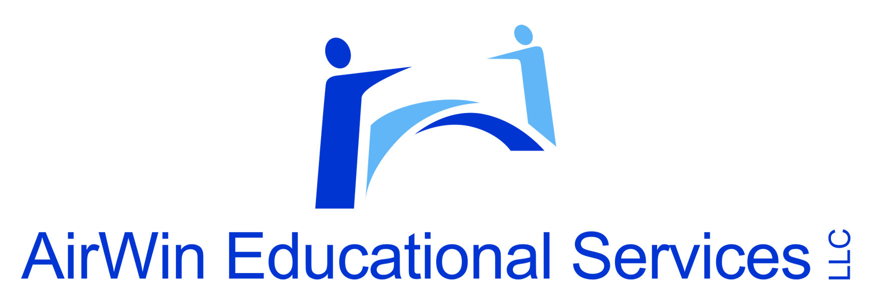
THANK YOU!
4521 Henry Drive
Beaverton, MI 48612
(989) 239-7555
angela@airwinllc.com

